Slide 1
CS5112: Algorithms and Data Structures for Applications
Reductions, lower bounds, approximation algorithms
Ramin Zabih
Some content from: Wikipedia, Abhiram Ranade (IIT), Jonathan Backer (UBC)

Slide 2
Administrivia
Lectures will be recorded “Real Soon Now” are recorded!
HW2 will be out Real Soon Now™
Prelim (midterm) date is Wednesday October 23
In class, closed book exam
Review session in class on Monday October 21
Bring your questions!

Slide 3
Lecture Outline
Roles in computer science
Lower bounds are hard
Sorting lower bound
Consequences
A 2-approximation algorithm for a TSP variant

Slide 4
What do we do with reductions?
Reductions turn one problem into another one
Light side: turn a seemingly hard one into an easy one
Many examples!
Dark side: show that your seemingly easy problem would also solve problems known to be hard
This is surprisingly useful
Beyond ‘uh oh, my problem is NP-hard’

Slide 5
Beyond upper bounds
In CS we compute worst case upper bounds
Big O and all that
Generally pretty useful, consistent with practice
We know how to figure out big O complexity
Though specific cases can be difficult to get a tight bound
Other options are harder
Average case requires a realistic input distribution
Often gives results that are inconsistent with practice

Slide 6
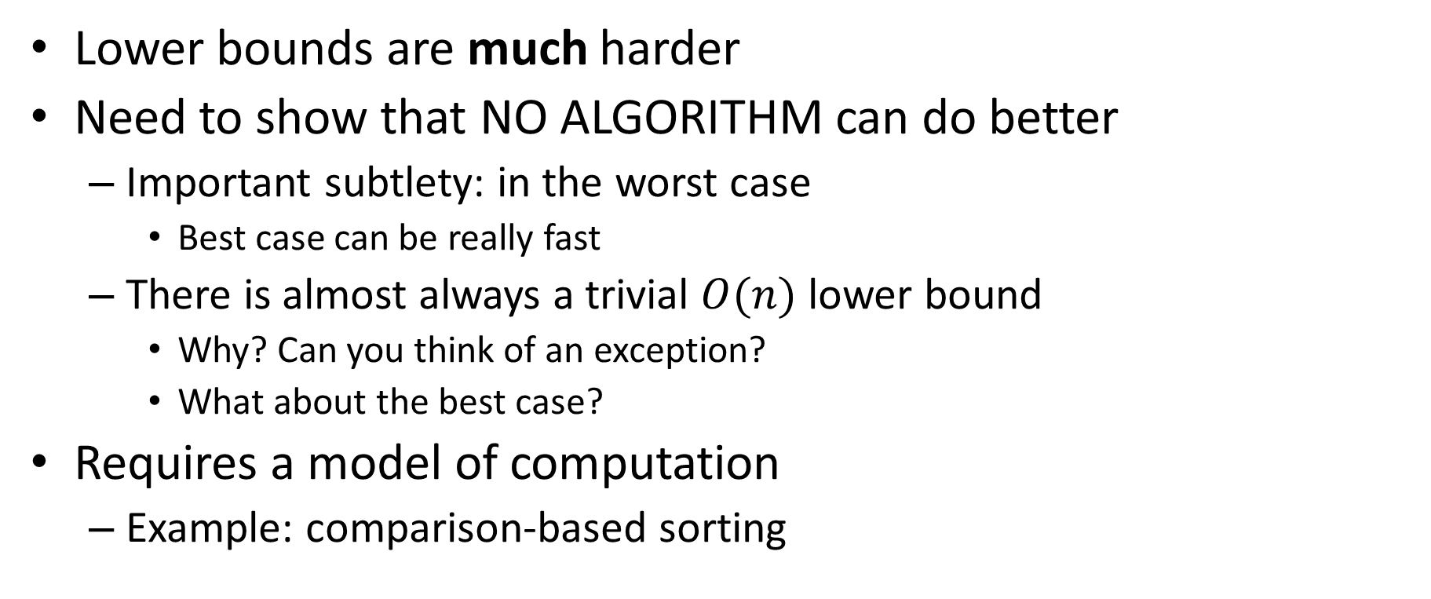
Lower bounds
Lower bounds are much harder
Need to show that NO ALGORITHM can do better
Important subtlety: in the worst case
Best case can be really fast
There is almost always a trivial $O(n)$ lower bound
Why? Can you think of an exception?
What about the best case?
Requires a model of computation
Example: comparison-based sorting

Slide 7
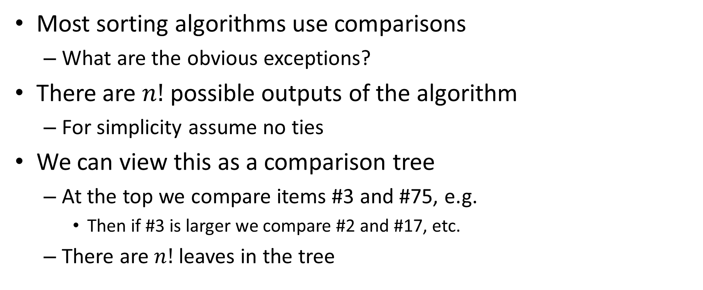
Comparison based sorting
Most sorting algorithms use comparisons
What are the obvious exceptions?
There are $n!$ possible outputs of the algorithm
For simplicity assume no ties
We can view this as a comparison tree
At the top we compare items #3 and #75, e.g.
Then if #3 is larger we compare #2 and #17, etc.
There are $n!$leaves in the tree

Slide 8
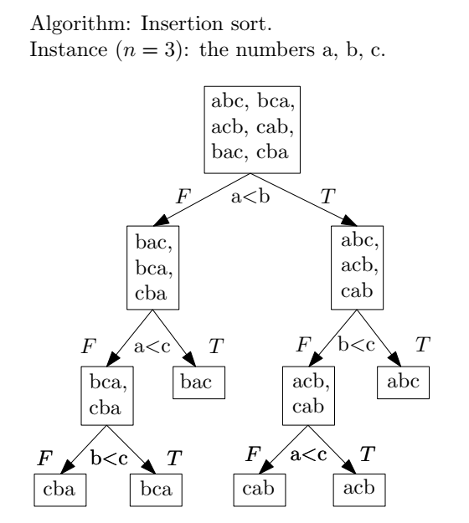
Comparison tree for insertion sort
Slide from: Jonathan Backer

Slide 9
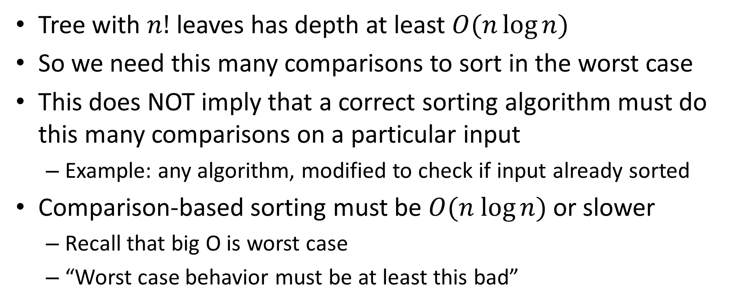
Lower bound for sorting
Tree with $n!$ leaves has depth at least $O(n\log{n})$
So we need this many comparisons to sort in the worst case
This does NOT imply that a correct sorting algorithm must do this many comparisons on a particular input
Example: any algorithm, modified to check if input already sorted
Comparison-based sorting must be $O(n log⁡n)$ or slower
Recall that big O is worst case
“Worst case behavior must be at least this bad”

Slide 10
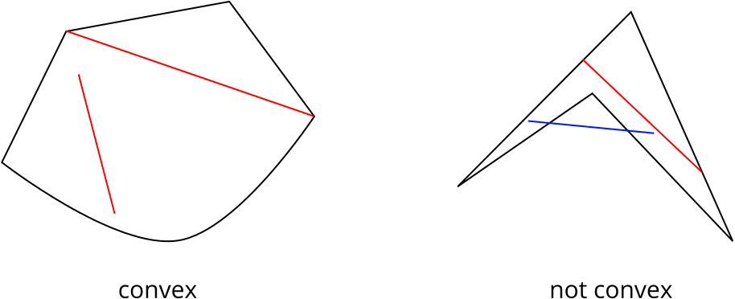
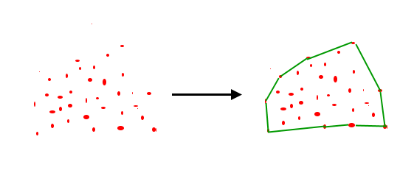
Convexity and convex hulls
Figure source
Figure source

Slide 11
Convex hull problem
Definition: a convex set contains the line between any two points in the set
This captures the intuition about convexity
Definition: the convex hull of a set of points is the smallest convex set containing those points
More precisely, the algorithm contains the points on the hull in a specific order (assume counter-clockwise)
How fast can we compute the convex hull?

Slide 12
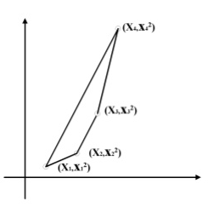
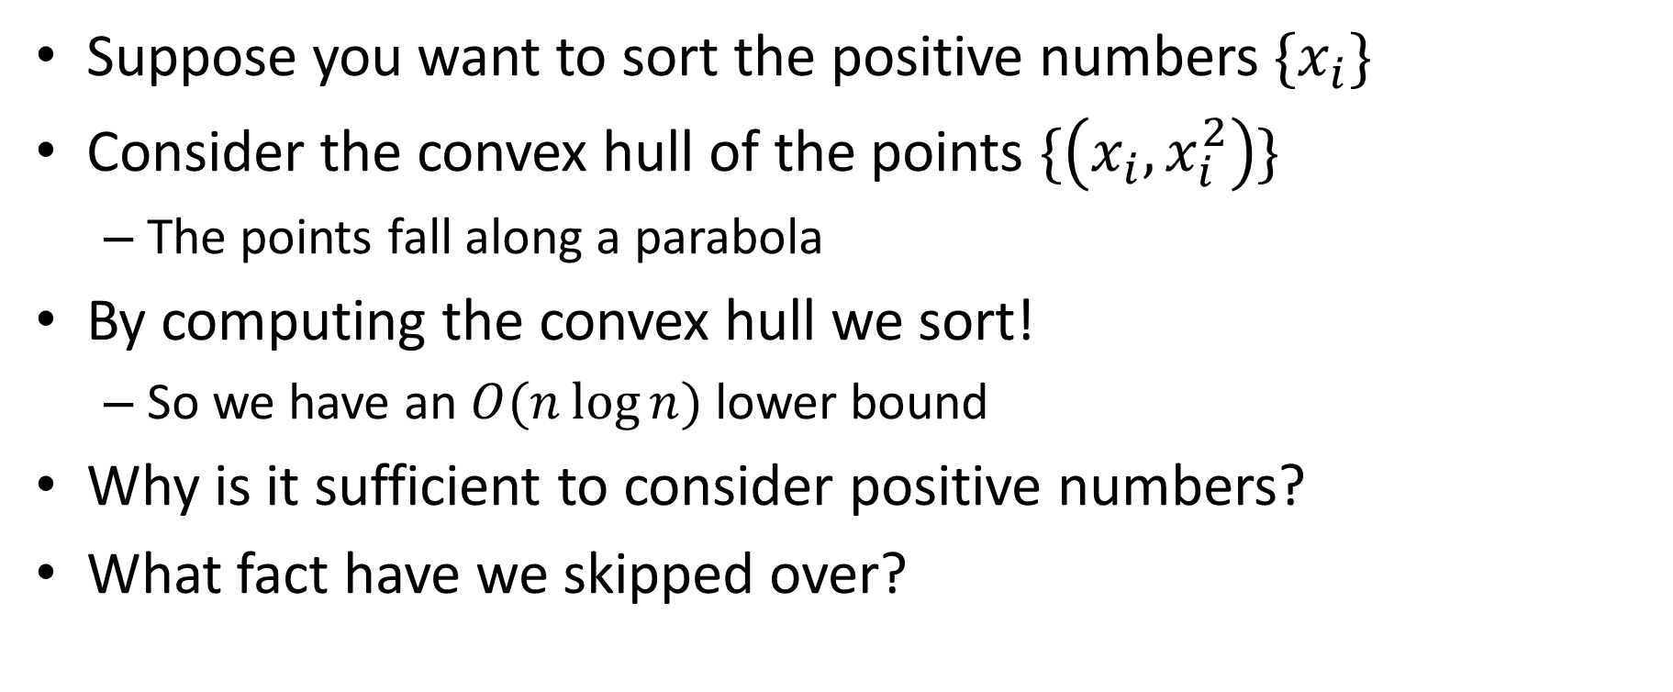
Sorting via convex hull
Suppose you want to sort the positive numbers $\{x_{i}\}$
Consider the convex hull of the points $\{\left(x_{i}, x_{i}^{2}\right)\}$
The points fall along a parabola
By computing the convex hull we sort!
So we have an $O(n\log{n})$ lower bound
Why is it sufficient to consider positive numbers?
What fact have we skipped over?
Figure source

Slide 13
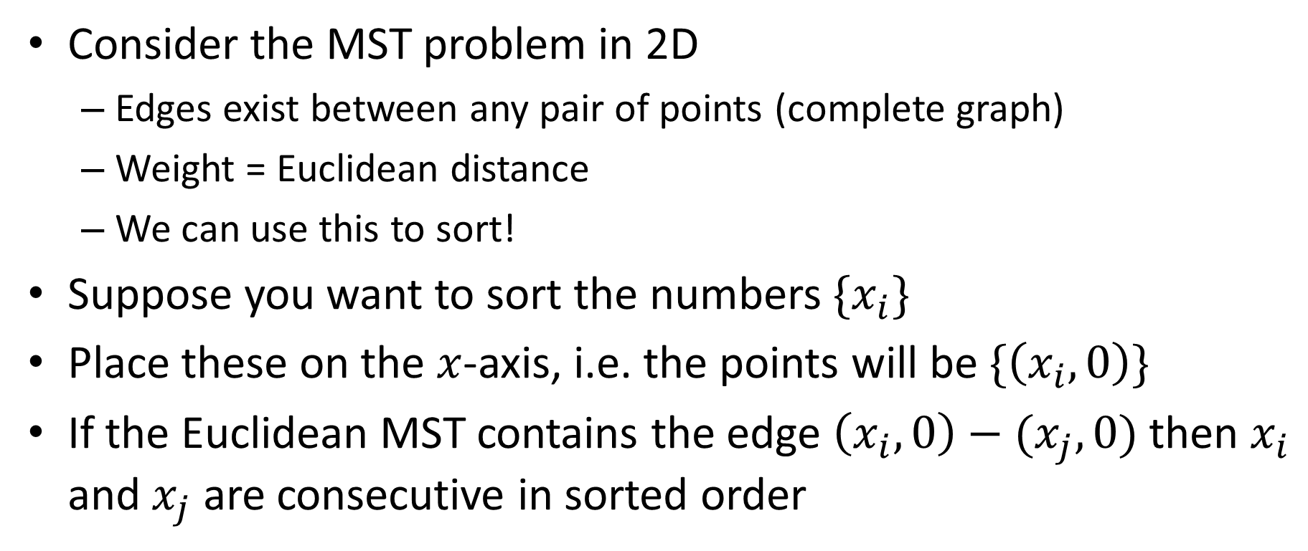
Euclidean MST
Consider the MST problem in 2D
Edges exist between any pair of points (complete graph)
Weight = Euclidean distance
We can use this to sort!
Suppose you want to sort the numbers $\{x_{i}\}$
Place these on the $x$-axis, i.e. the points will be $\{\left(x_{i},0\right)\}$
If the Euclidean MST contains the edge $\left(x_{i},0\right)−(x_{j}, 0)$ then $x_{i}$ and $x_{j}$ are consecutive in sorted order

Slide 14
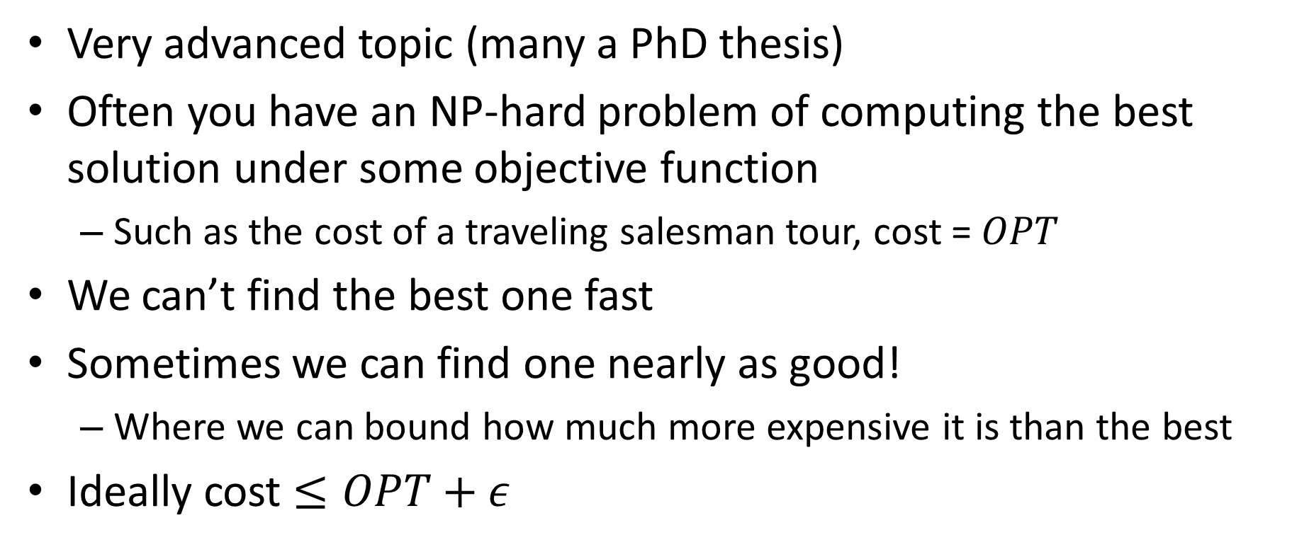
Approximation algorithms
Very advanced topic (many a PhD thesis)
Often you have an NP-hard problem of computing the best solution under some objective function
Such as the cost of a traveling salesman tour, cost = $OPT$
We can’t find the best one fast
Sometimes we can find one nearly as good!
Where we can bound how much more expensive it is than the best
Ideally cost $≤OPT+ε$

Slide 15
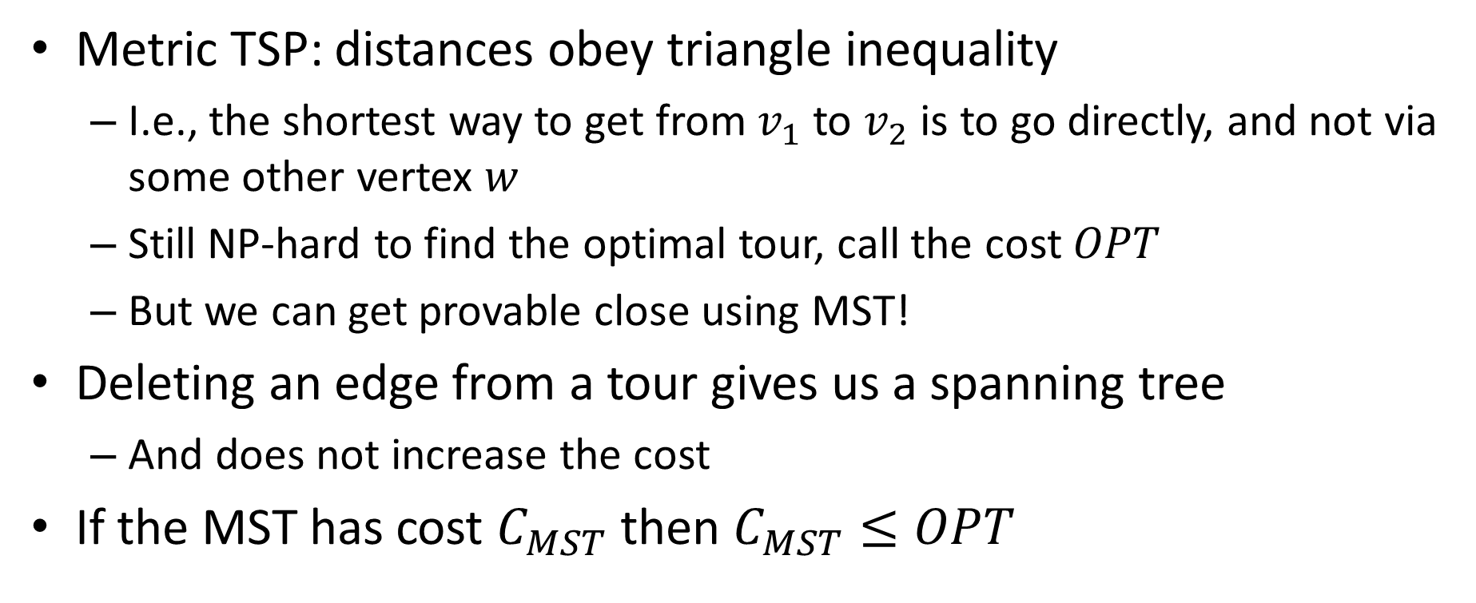
Approximation algorithm for metric TSP
Metric TSP: distances obey triangle inequality
I.e., the shortest way to get from $v_{1}$to $v_{2}$is to go directly, and not via some other vertex $w$
Still NP-hard to find the optimal tour, call the cost $OPT$
But we can get provable close using MST!
Deleting an edge from a tour gives us a spanning tree
And does not increase the cost
If the MST has cost $C_{MST}$ then $C_{MST}≤OPT$

Slide 16
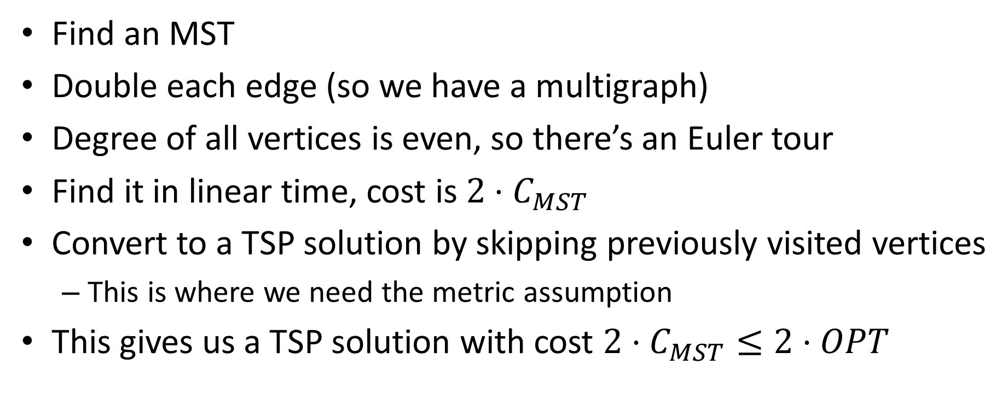
The 2-approximation algorithm
Find an MST
Double each edge (so we have a multigraph)
Degree of all vertices is even, so there’s an Euler tour
Find it in linear time, cost is $2⋅C_{MST}$
Convert to a TSP solution by skipping previously visited vertices
This is where we need the metric assumption
This gives us a TSP solution with cost $2⋅C_{MST}≤2⋅OPT$

